Slide 1
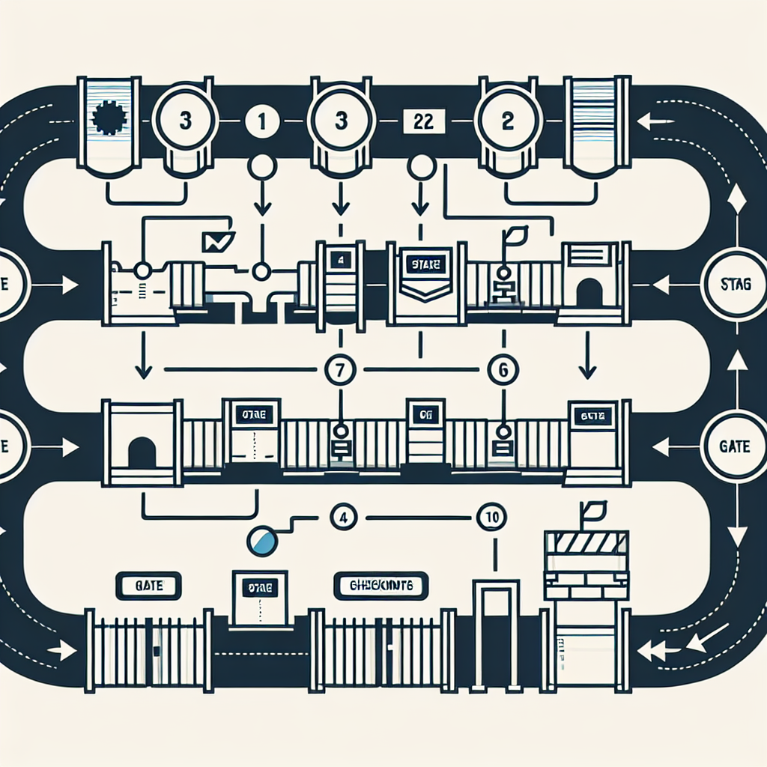
Data/ML Lifecycle Controls
Data Sourcing — Provenance/consent checks; Sensitive data minimization; Data quality SLAs
Development — Documented objectives/use constraints; Training/validation splits; Secure training pipelines
Evaluation — Accuracy/robustness tests; Bias/fairness metrics by cohort; Adversarial/red‑team exercises
Approval — Impact assessment (AIA/DPIA); Human oversight design; Regulatory mapping + sign‑offs
Deployment — Feature flags/kill‑switch; User notices/labeling; Access controls/abuse monitoring
Monitoring — Drift detection; Incident logging/triage; Periodic re‑validation and model cards updates
Gates: Gate 1 (Build complete), Gate 2 (Risk/Privacy review), Gate 3 (Independent validation), Gate 4 (Go‑live), Gate 5 (Periodic review)

